Slide 1
Thinking about high dimensional data
Machine Learning for Single Cell Analysis
Day 1 – Morning session

Slide 2
Goals for this unit
Thinking about data as a point in a high-dimensional space
Introduce vectors, matrices, and common notation
Calculating distances between points
Introduction to the Numpy / Scipy / Pandas / Sklearn ecosystem

Slide 3
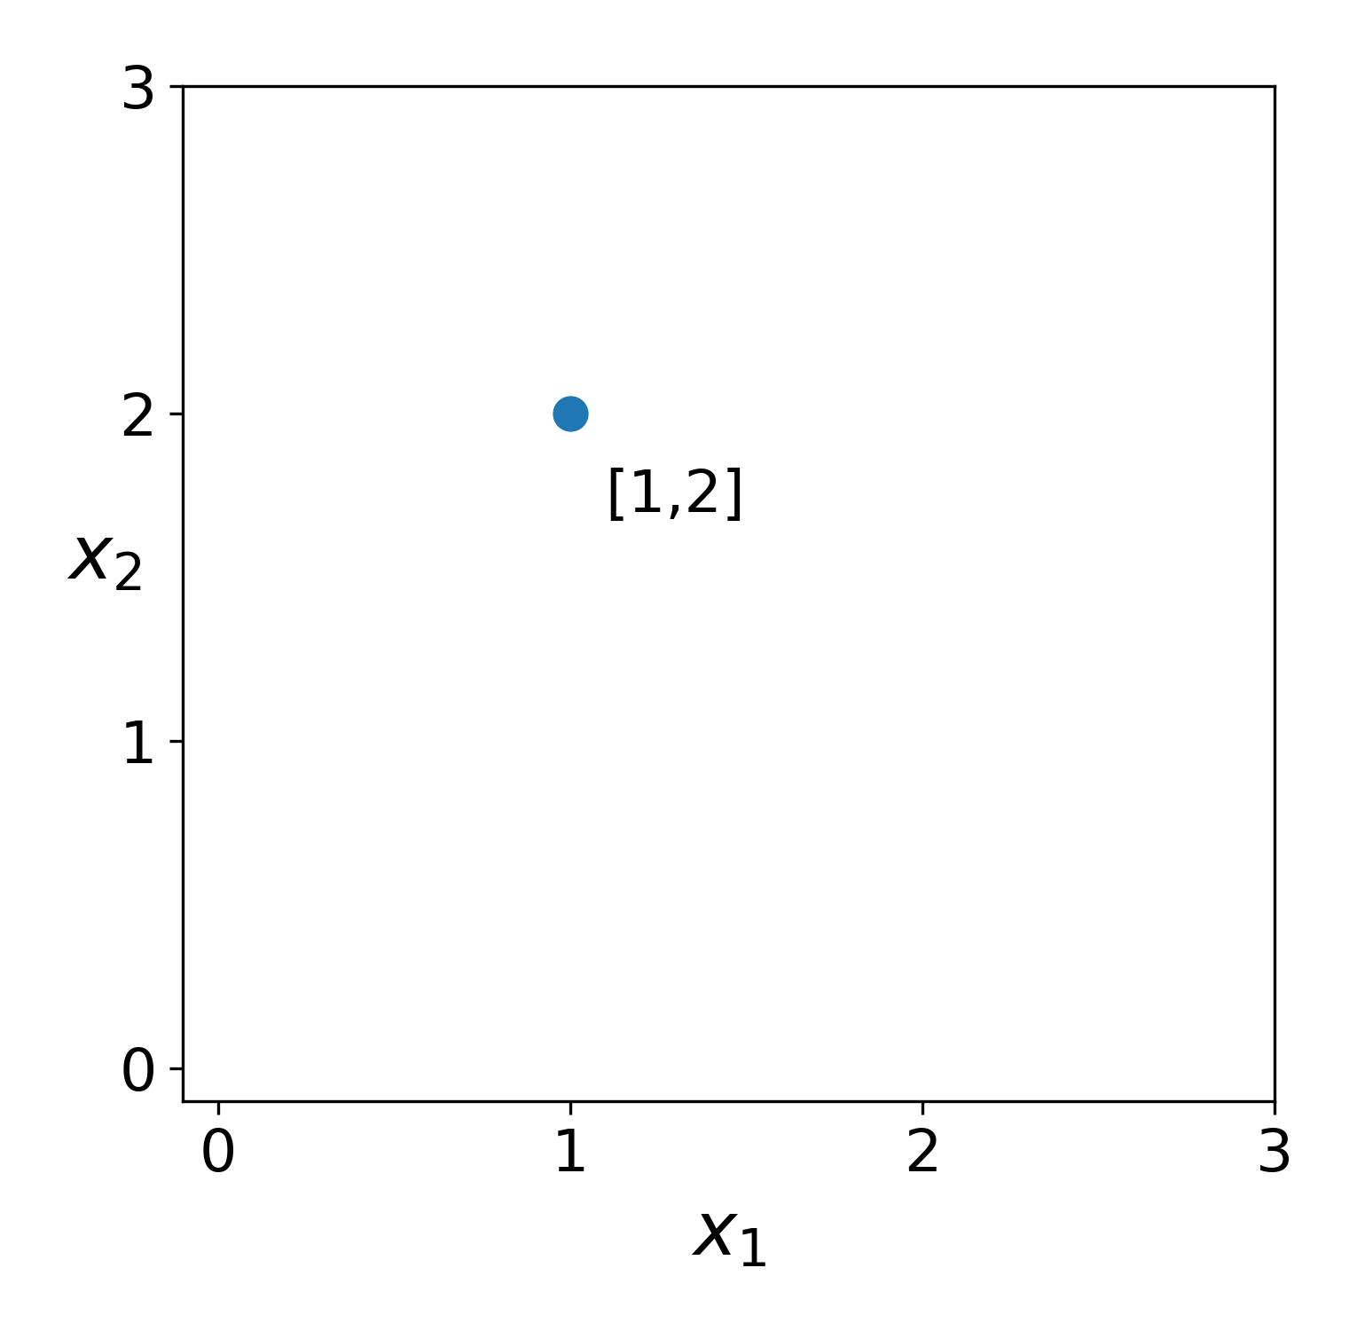
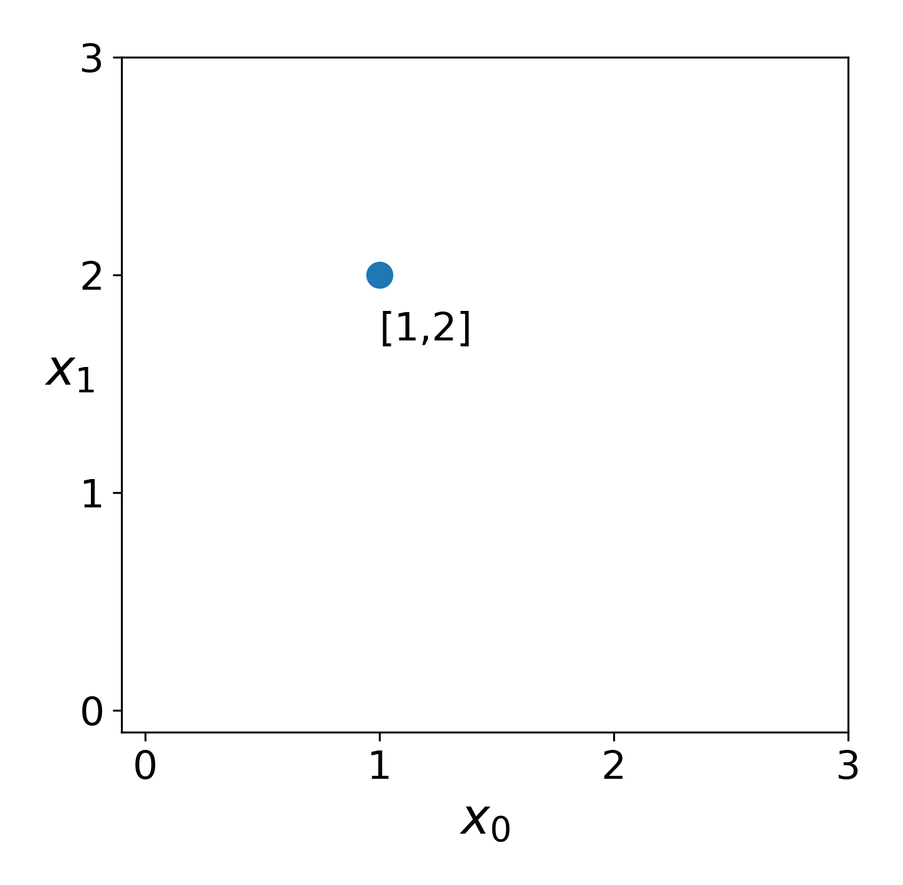
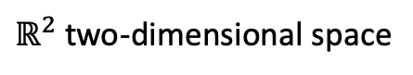

What does “dimensionality” mean?
$ℝ^{2}$ two-dimensional space
$$a$$

Slide 4
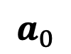
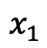
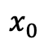
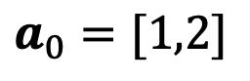
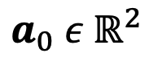
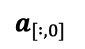
What does “dimensionality” mean?
vector
coordinate space
$ℝ^{2}$ two-dimensional space
$$a_{0} ε{ ℝ}^{2}$$
$$a_{0}=[1,2]$$
$$a_{0}$$
$$x_{0}$$
$$x_{1}$$
features
$$a_{[ :,0]}$$

Slide 5
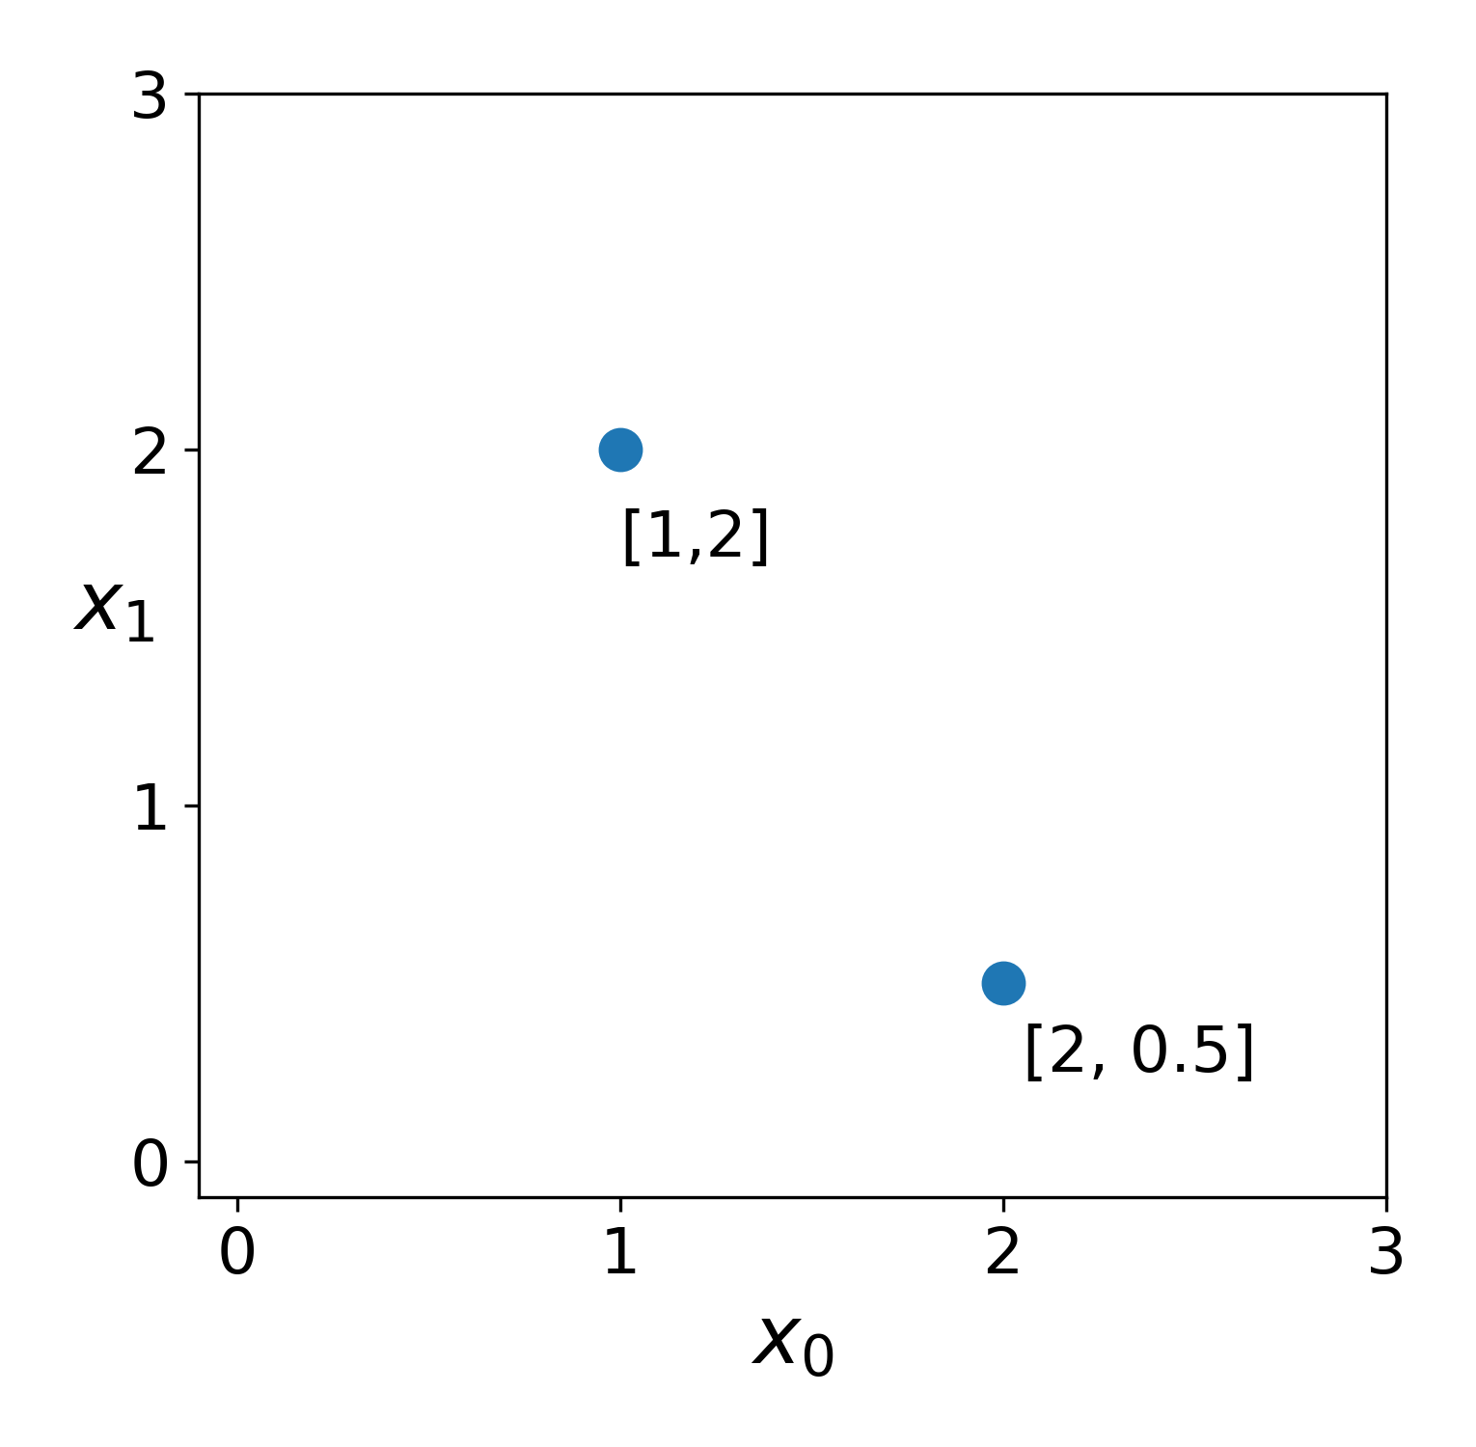
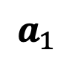
What does “dimensionality” mean?
vector
coordinate space
$ℝ^{2}$ two-dimensional space
$$a_{0} ε{ ℝ}^{2}$$
$$a_{0}=[1,2]$$
$$a_{0}$$
$$x_{0}$$
$$x_{1}$$
features
$$a_{1}$$
$$a_{[ :,0]}$$

Slide 6
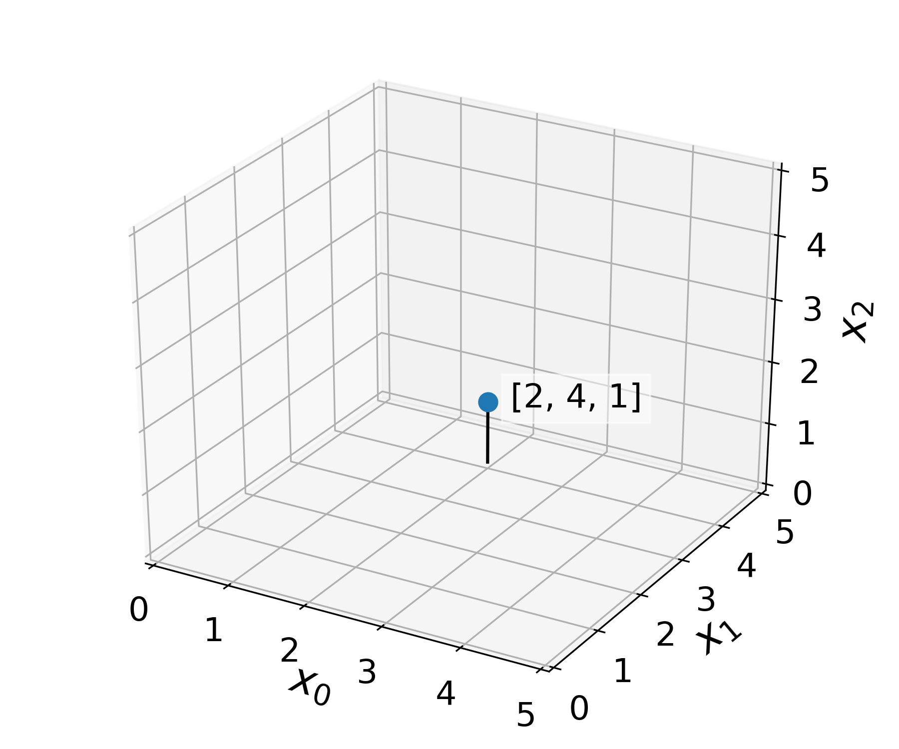
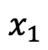
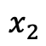
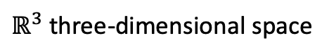
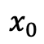
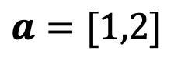
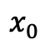
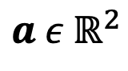
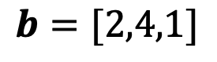

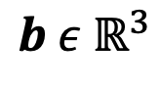
What does “dimensionality” mean?
$$a ε{ ℝ}^{2}$$
$ℝ^{3}$ three-dimensional space
$$a=[1,2]$$
$$x_{0}$$
$$x_{1}$$
$$b ε{ ℝ}^{3}$$
$$b=[2,4,1]$$
$$b$$
$$x_{0}$$
$$x_{1}$$
$$x_{2}$$

Slide 7
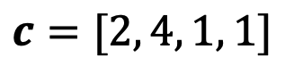
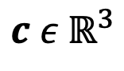
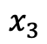
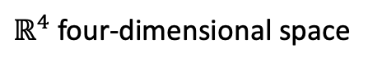
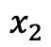
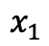
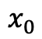
What does “dimensionality” mean?
$$a ε{ ℝ}^{2}$$
$ℝ^{4}$ four-dimensional space
$$a=[1,2]$$
$$x_{0}$$
$$x_{1}$$
$$b ε{ ℝ}^{3}$$
???
$$b=[2,4,1]$$
$$x_{0}$$
$$x_{1}$$
$$x_{2}$$
$$c ε{ ℝ}^{3}$$
$$c=[2, 4, 1, 1]$$
$$x_{0}$$
$$x_{1}$$
$$x_{2}$$
$$x_{3}$$

Slide 8
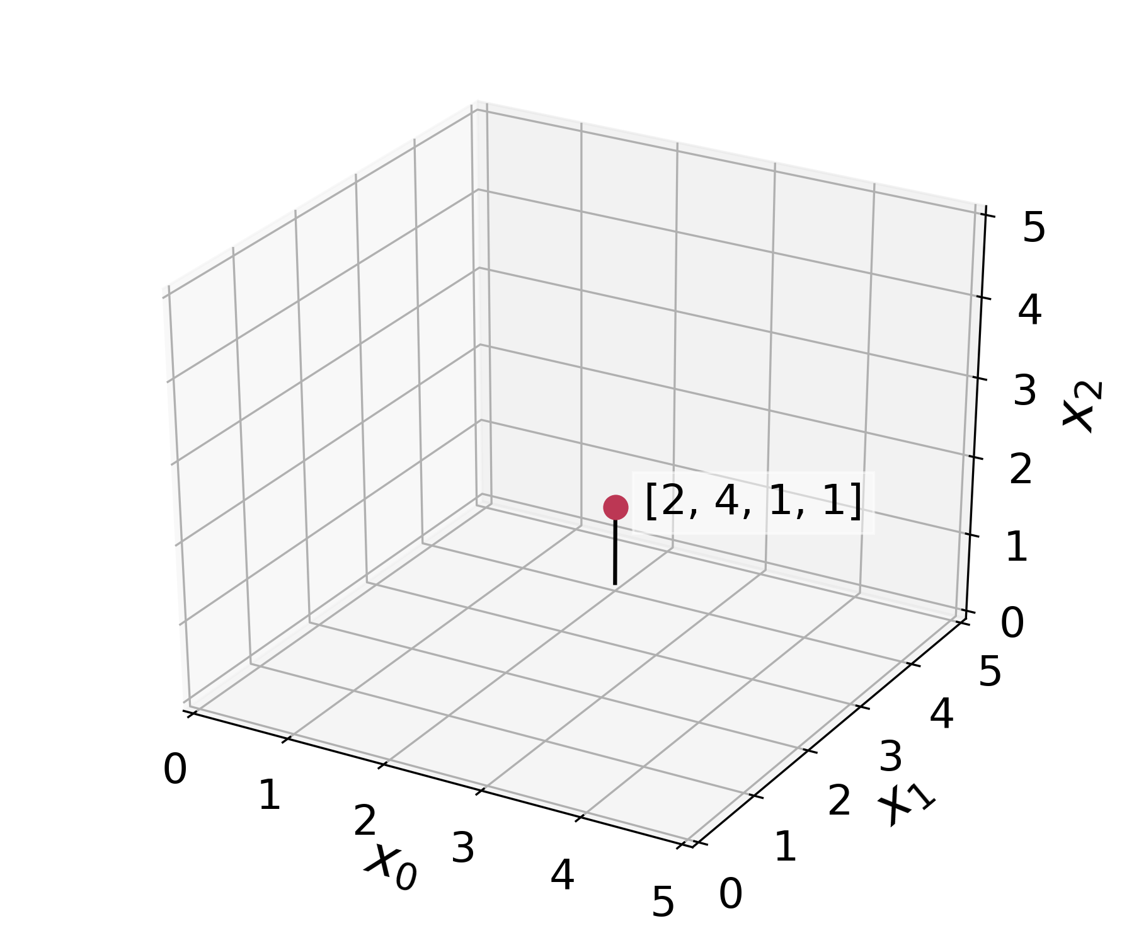


What does “dimensionality” mean?
$$a ε{ ℝ}^{2}$$
$ℝ^{4}$ four-dimensional space
$$a=[1,2]$$
x₃
2
$$x_{0}$$
$$x_{1}$$
$$b ε{ ℝ}^{3}$$
$$b=[2,4,1]$$
$$c$$
1
$$x_{0}$$
$$x_{1}$$
$$x_{2}$$
$$c ε{ ℝ}^{3}$$
0
$$c=[2, 4, 1, 1]$$
$$x_{0}$$
$$x_{1}$$
$$x_{2}$$
$$x_{3}$$

Slide 9
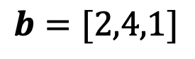
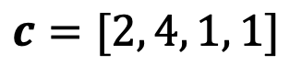
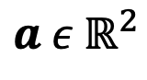
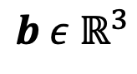
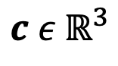
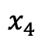
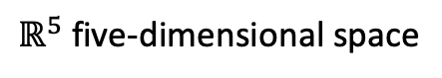
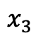
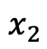
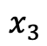
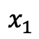
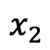
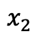
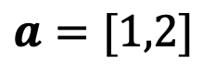
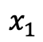
What does “dimensionality” mean?
$ℝ^{5}$ five-dimensional space
$$a ε{ ℝ}^{2}$$
$$a=[1,2]$$
$$x_{1}$$
$$x_{2}$$
$$b ε{ ℝ}^{3}$$
???
$$b=[2,4,1]$$
$$x_{1}$$
$$x_{2}$$
$$x_{3}$$
$$c ε{ ℝ}^{3}$$
$$c=[2, 4, 1, 1]$$
$$x_{1}$$
$$x_{2}$$
$$x_{3}$$
$$x_{4}$$

Slide 10
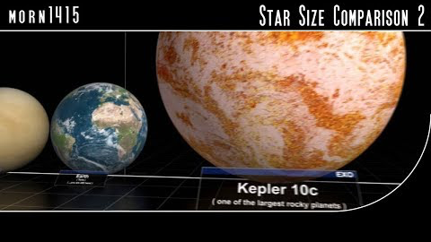
What’s it like to think about high dimensions?
v
Scale of Stars

Slide 11
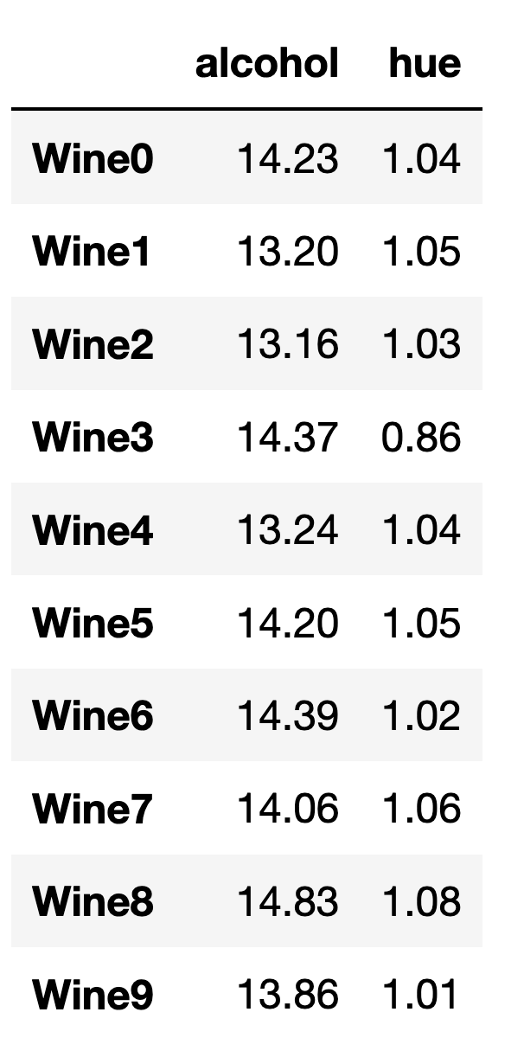
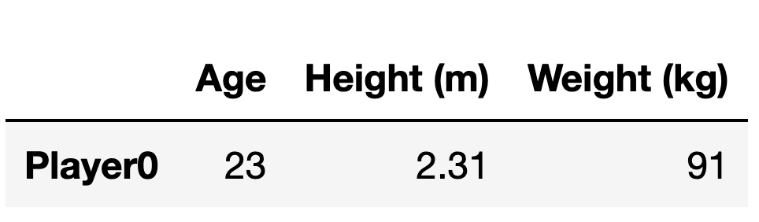
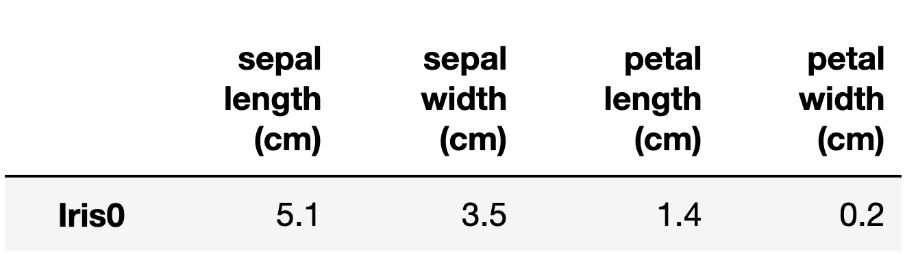
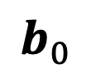
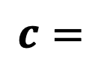






What do x₁ x₂, …, x_{n} represent?
We describe coordinate spaces of $n$ dimensions as $ℝ^{n}$
$$a=$$
$$b=$$
$$a_{0}$$
$$a_{1}$$
$$b_{0}$$
$$b_{1}$$
$$b_{2}$$
$$c=$$
UCI ML Wine Data Set

Slide 12




What if we have more than one observation?
columns (features)
$$a=$$
$$a_{0}$$
$$a_{1}$$
$$A=$$
rows
(observations)
matrix
UCI ML Wine Data Set

Slide 13

What if we have more than one observation?
columns (features)
$$a=$$
$$a_{0}$$
$$a_{1}$$
$$A=$$
$$ε{ ℝ}^{2}$$
matrix
UCI ML Wine Data Set

Slide 14





How do we reference specific observations in a matrix?
$$x_{0}$$
$$x_{1}$$
$$A_{\left[0, :\right]}$$
$$A_{\left[row, column\right]}$$
$$A=$$

Slide 15






What if we have more than one observation?
We can describe coordinate spaces of $n$ dimensions as $ℝ^{n}$
$$x_{0}$$
$$x_{1}$$
$$A_{\left[0, :\right]}=a_{0}=$$
$$A_{\left[0,0\right]}$$
$$A_{\left[0,1\right]}$$
$$A=$$

Slide 16




What if we have more than one observation?
We can describe coordinate spaces of $n$ dimensions as $ℝ^{n}$
$$x_{0}$$
$$x_{1}$$
$$A_{\left[0, :\right]}=$$
$$A_{\left[0,0\right]}$$
$$A_{\left[0,1\right]}$$
$$A=$$
$$A_{\left[9, :\right]}=$$
$$A_{\left[9,1\right]}$$
$$A_{\left[9,1\right]}$$

Slide 17

Exercise!
Loading and plotting the UCI wine dataset

Slide 18

Exercise!
Loading and plotting the UCI wine dataset

Slide 19
Introducing scprep
Code: https://github.com/KrishnaswamyLab/scprep
Docs: https://scprep.readthedocs.io
Modules
filter
io
measure
normalize
plot
reduce
run
select
stats
transform
utils
Plotting functions:
histogram
jitter
marker
marker_plot
plot_gene_set_expression
plot_library_size
rotate_scatter3d
scatter
scatter2d
scatter3d
scree
scree_plot
= scprep.plot.scatter2d

Slide 20
Exercise!
Loading and plotting the UCI wine dataset

Slide 21


How do features differentiate groups within a dataset?

Slide 22
Goals for this unit
Thinking about data as a point in a high-dimensional space
Introduce vectors, matrices, and common notation
Calculating distances between points
Introduction to the Numpy / Scipy / Pandas / Sklearn ecosystem

Slide 23
Introduction to Manifold Learning

Slide 24





How far away is each point from $a_{0}?$
$$a_{1}$$
$$a_{0}$$
$$a_{2}$$

Slide 25








How far away is each point from $a_{0}?$
Euclidean distance
$$a_{1}$$
$$d_{euclidean}\left(a_{0},a_{1}\right)= {\left\|a_{0}−a_{1}\right\|}_{2}^{2}$$
$$\text{2.24}$$
$$=\sqrt{{{(a}_{0,0} −a_{1,0})}^{2}+{{(a}_{0,1} −a_{1,1})}^{2}}$$
$$a_{0}$$
$$a_{2}$$
$$=\sqrt{{(1 −2)}^{2}+{(2 −4)}^{2}}$$
$$≈2\text{.24}$$

Slide 26




How far away is each point from $a_{0}?$
$$a_{1}$$
$$a_{0}$$
$$a_{2}$$

Slide 27
How far away is each point from $a_{0}?$
$$a_{1}$$
$$a_{0}$$
$$a_{2}$$

Slide 28


How far away is each point from $a_{0}?$
$$a_{1}$$
$$a_{0}$$
$$a_{2}$$

Slide 29
How far away is each point from $a_{0}?$
$$a_{1}$$
$$a_{0}$$
$$a_{2}$$

Slide 30







How far away is each point from $a_{0}?$
Manhattan distance
$$a_{1}$$
$$d_{manhattan}\left(a_{0},a_{1}\right)= {\left\|a_{0}−a_{1}\right\|}_{2}^{2}$$
$$={|a}_{0,0} −a_{1,0}|+|a_{0,0} −a_{1,0}|$$
$$a_{0}$$
$$a_{2}$$
$$=|1 −2|+|2−4|$$
$$=3$$

Slide 31





How far away is each point from $a_{0}?$
$$a_{1}$$
$$a_{1}$$
$$a_{2}$$
$$a_{2}$$
$$a_{0}$$
$$a_{0}$$

Slide 32

Exercise!
Calculating distances
Distance defines structure in a dataset
How different are two data points?
How many types exist in my dataset?
Which types are closest to each other?
Which features vary between dissimilar groups of data?
Dist

Slide 33



What is a manifold?
Surface in $ℝ^{3}$
Local view in $ℝ^{2}$
Locally smooth
Locally Euclidean
Generally, lower dimensional than the ambient space (i.e. a subspace)
Notes:
Mention that the “manifold dimensionality” of this manifold is 2d

Slide 34

NHV
MEX
Notes:
Ask, what is the intrinsic dimensionality of a sphere?

Slide 35

How far is NHV -> MEX?

Slide 36

How far is NHV -> MEX?

Slide 37

How far is NHV -> MEX?

Slide 38
How far is NHV -> MEX?
Manifold distance
Euclidean distance

Slide 39

Is a circle locally Euclidean?

Slide 40

Is a circle locally Euclidean?
# segments = 2

Slide 41

Is a circle locally Euclidean?
# segments = 4

Slide 42

Is a circle locally Euclidean?
# segments = 100

Slide 43
Is a circle locally Euclidean?
Key Insight:
Manifolds are locally Euclidean,
but not globally Euclidean

Slide 44
Is a circle locally Euclidean?
Key Insight:
Manifolds are locally Euclidean,
but not globally Euclidean
How do we define local versus global when we only have a collection of points?

Slide 45
We do we quantify local vs global in a dataset?

Slide 46
Exercise!
To do: figure out how to get people to figure out
the “shape” of a dataset without being able to easily visualize it.

